Slide 1
Module 4
Open Science 101

Slide 2
Opening questions
Big overarching question – what should community engaged research look like?
How is open science part of it?
How should this look in upcoming projects?
Who should do what?
What capacity development should we focus on?

Slide 3
What kind of software do we make in community-engaged research?
Maps
Data analysis
Graphs, visualizations
Data collection and cleaning
?

Slide 4
Purpose – why have a software management plan?
Fedral grants
In communnity-engaged research, who should handle any software development? Manage the software plan?
Could this capacity be develloped with other partners? Who? How?

Slide 5
Definitions
Source code
Human-readable set of statements written in a programming language that together compose software. Programmers write software in source code, often saved as a text file on a computer. The terms code and source code are often used interchangeably.
Version control
A system to automatically manage changing versions of a computer file, especially one that contains source code. In software development, version control preserves a complete history of changes to the source code and enables a developer to roll back to an earlier version if needed.
Code repository
A central storage location for the source code. Code repositories may contain source code in one or more programming languages. Repositories may provide tools for merging inputs from developers, automated testing to verify the proper functioning of source code, version control to track changes over time, and project management features. These sites may not promise long-term retention.

Slide 6
Who has done any coding?
Why would we want or need to use code?

Slide 7
What are benefits of open source software?
What are concerns about open source software?

Slide 8
NASA requires open access to software
"Data and software developed using Research Opportunities in Space and Earth Sciences (ROSES) funding in support of a peer-reviewed publication shall be made publicly available at the time of publication"

Slide 9
When to restrict code
military secret
intelectual property or patent
institutional policies

Slide 10
Open source definition
Open Source Definition
  “must allow modifications and derived works, and must allow them to be distributed under the same terms as the license of the original software(opens in a new tab).”
Software licence?

Slide 11
Software management plan
what
Description of types, management, preservation, and release of software.
When
The schedule for software archiving and sharing.
Where
Location where software will be shared and archived over the long term.
How
Enable reuse of software through assigning a DOI, license, contribution guidelines, etc.
Who
Roles and responsibilities of the team members.

Slide 12
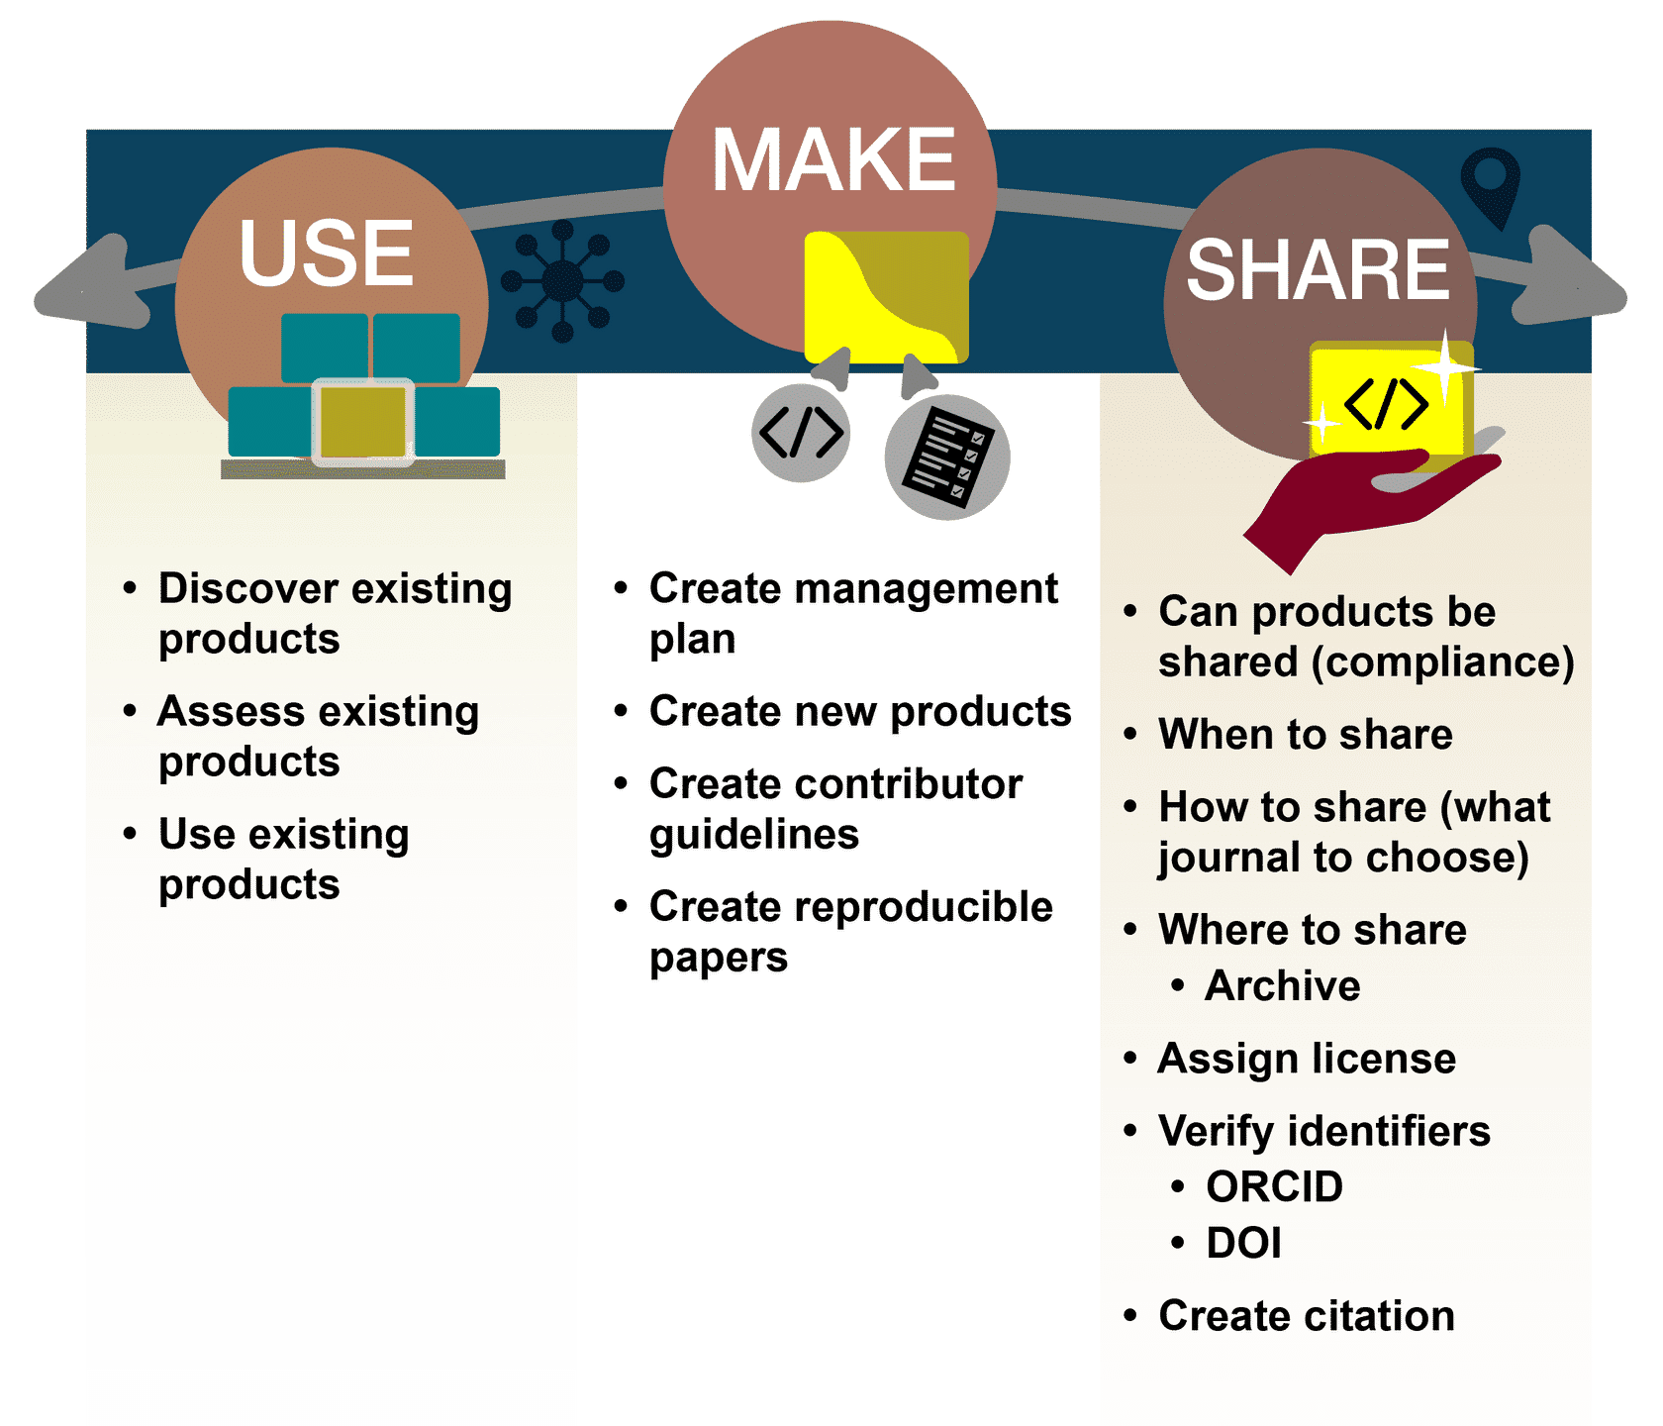

Slide 13
Does FAIR apply to software too?
Where do you get help if you have a problem with open source software?

Slide 14
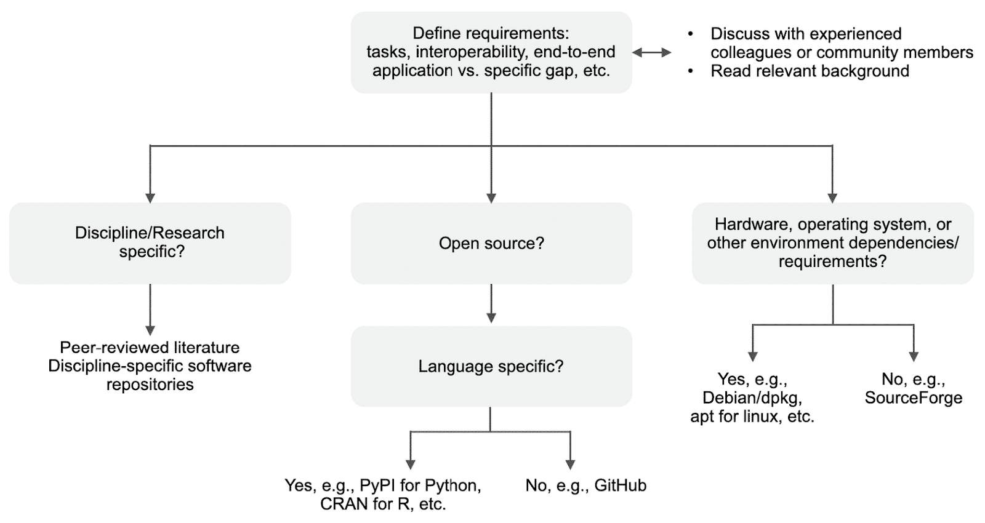

Slide 15

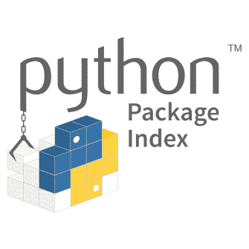







Slide 16

Lesson 1&2 Quiz

Slide 17
making open code

Slide 18
Starting a New Software Project
Define the project scope, its primary features and any limitations, and the intended audience.
Consider resources required for the software to run. Will it be on a personal computer, a high-performance computing server, or on the cloud?
How will it be managed?

Slide 19
Benefits of open development of code
It enables open collaboration.
It invites constructive feedback that contributes to a code’s accuracy and robustness.
People with less experience with the subject matter will learn more.
Those with less programming experience can learn from those with more programming experience as they improve the code.
It provides an intermediate product that can still be cited.

Slide 20
Version control
Helps developers keep track of changes to a project’s code (as well as supplemental files and documentation) over the entire course of a project’s evolution.
Revisions to a project’s files can be tracked, including contributions made by different people.
Undesirable changes (like errors or bugs) can be reverted at any time.

Slide 21
README files – good and bad example
EX 1.
This code recomputes the fundamental permutation factor of the downward flow (for J < 10, obviously).”
EX 2. LeapKitten.py
This Python software package takes any picture of a kitten (JPEG, PNG) and uses artificial intelligence to output what it would look like leaping into the air. In addition, the code takes leap years into account on the timestamp on the image.

Slide 22
Include in a README
A list of any code dependencies the software has
How to install and a brief description of how to run the software.
Detailed description of the software, especially if there is no external documentation.
Examples of how to use the software.
Acknowledgement of team members or sources of support.

Slide 23
Other good documentation
Contributor Guidelines
Code of Conduct
Code Documentation – how to put notes in the code

Slide 24
Licenses
Permissive (more open) -guarantees the freedoms to use, modify, redistribute, and create derivative works
Protective (more like copy right, with some permission) - users to reuse, but also requires users to share their changes with the community using the same license
Apache License
MIT license
BSD License
GNU General Public License (GPL)
Mozilla Public License
Common Development and Distribution License (CDDL)

Slide 25
Lesson 3 Quiz

Slide 26

Benefits of sharing code
Reproducibility
collaborations
inclusivity?
save resources?
required?

Slide 27
software development plan
What: Description of management, preservation, and release of software.
When: The schedule for code archiving and sharing.
Where: Location where software will be shared and archived over the long-term.
How: Enable reuse of software through assigning a DOI, license, contribution guidelines, etc.
Who: Roles and responsibilities of the team members.

Slide 28
options for sharing
Archive open code with an open access journal article.
Github, then create a version and archive the code at a long-term repository with a DOI such as Zenodo
Archive the code in other long-term public repositories, such as Software Heritage, Source Forge

Slide 29
more sharing
Publish to a software repository used by common package managers to make the software easy for users to install (ex. Anaconda, CRAN, PyPI).
Present the software at conferences.
Publish the software in a Journal dedicated to open software (ex. JOSS).
Get your software peer reviewed through communities like PyOpenSci.

Slide 30
helping reuse – do ay of these also help inclusivity?
Choose the appropriate software sharing license
Producing a persistent identifier for your code is the best way to make it citable
CITATION files are a means to make citation information easily accessible in open source software repositories.
CONTRIBUTING and CODE_OF_CONDUCT files in your repository that outline expectations for member interactions.

Slide 31
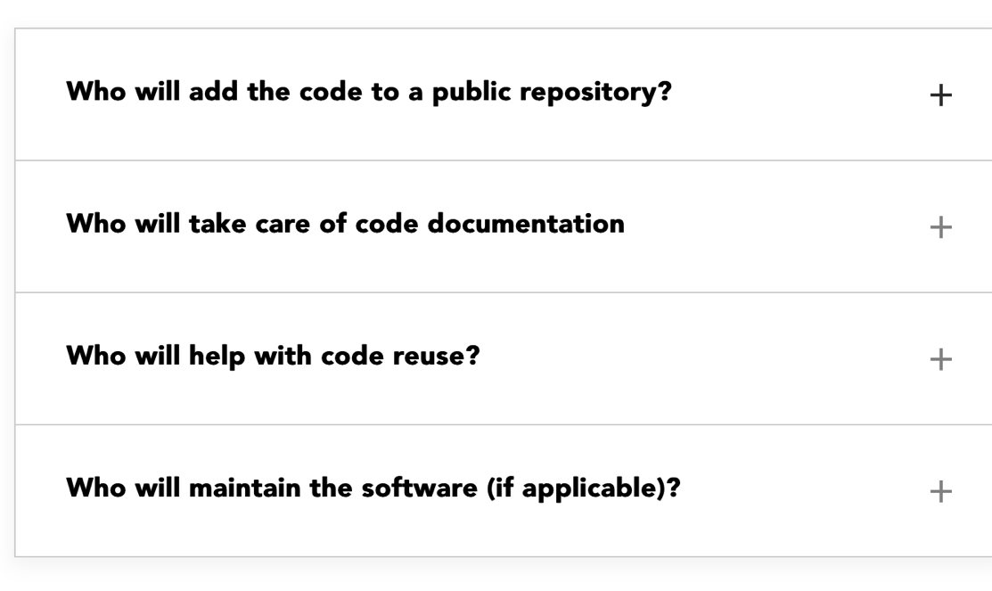
Roles on the software plan

Slide 32
Open source software communities
A non-hierarchical community of practice where all members of the community should be treated equally.
rOpenSci
pyOpenSci
R-Ladies
PyLadies
GitHub discussions

Slide 33
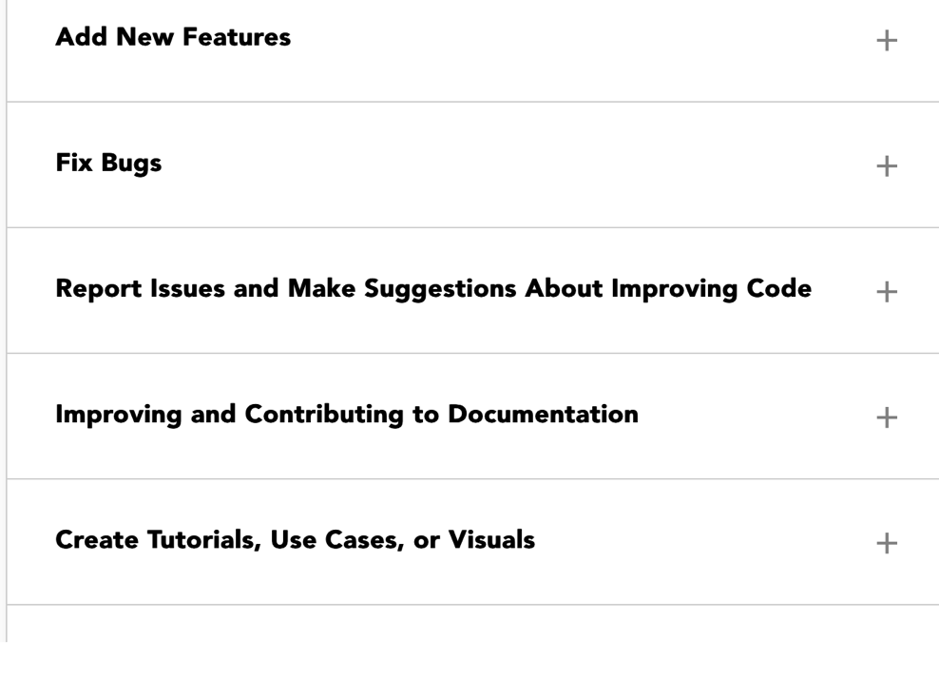
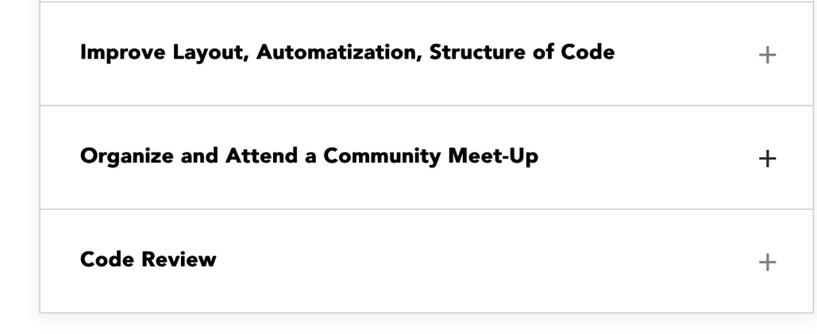
contribute

Slide 34
Lesson 4&5 Quiz

